Slide 1
K-Nearest Neighbors and Naive Bayes
Xiaochun MAI
Shenzhen University

Slide 2

Outline
K-Nearest Neighbors
Naive Bayes

Slide 3
Types of classifiers
We can divide the large variety of classification approaches into roughly three main types
1. Instance based classifiers
Use observation directly (no models)
e.g. K-nearest neighbors
2. Generative
Build a generative statistical mode-Linear discriminant analysis (LDA), QDA and Naive Bayes
3. Discriminative
Directly estimate a decision rule/boundary-Logistic regression, decision tree, K-nearest neighbors, support vector machines(SVM), neural networks

Slide 4
K-Nearest Neighbors (KNN)
KNN is a nonparametric models, that keep the training data around. Thus the effective number of parameters of the model can grow with the size of the data.
Defined in terms of the similarity between a test input, x, and each of the training inputs, x_{n}.
The models are called exemplar-based models, instance-based learning, or memory-based learning.

Slide 5

K-Nearest Neighbors (KNN)
The idea is: to classify a new input x, we find the K closest examples to x in the training set, denoted N_{K}(x, D), and then look at their labels, to derive a distribution over the outputs for the local region around x. More precisely, we compute

Slide 6

K-Nearest Neighbors (KNN)
Main parameters：
the size of the neighborhood, K, and
the distance metric d(x, x’). For the latter, it is common to use the Mahalanobis distance
where M is a positive definite matrix. If M = I, this reduces to Euclidean distance.

Slide 7
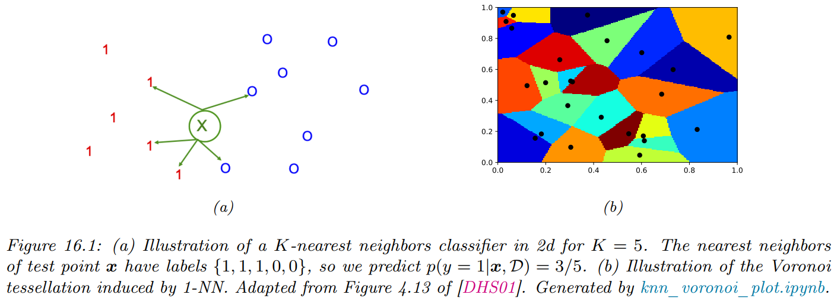
K-Nearest Neighbors (KNN)
Example

Slide 8
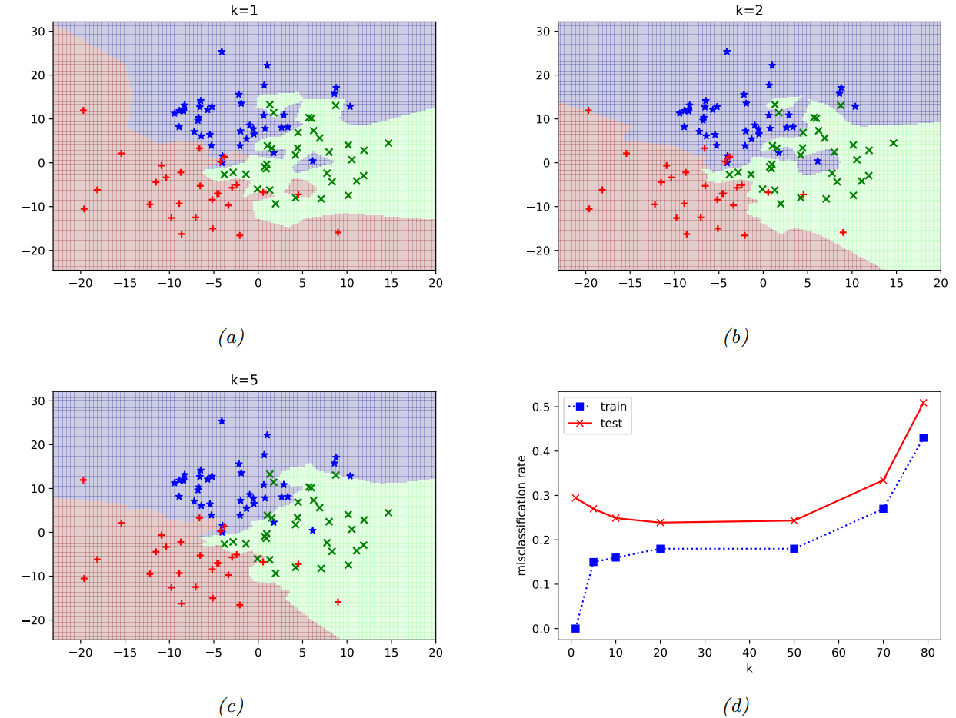
K-Nearest Neighbors (KNN)
Figure: Decision boundaries induced by a KNN classifier. (a) K = 1. (b) K = 2. (c) K = 5. (d) Train and test error vs K.

Slide 9
K-Nearest Neighbors (KNN)
Reducing the speed and memory requirements
KNN classifiers store all the training data. This is obviously very wasteful of space. Solution: (a) Remove points that do not affect the decision boundaries. (b) Sparse kernel machine, only keeps a subset of the most useful exemplars.
In terms of running time, the challenge is to find the K nearest neighbors in less than O(N) time, where N is the size of the training set. Finding exact nearest neighbors is computationally intractable when the dimensionality of the space goes above about 10 dimensions, so most methods focus on finding the approximate nearest neighbors. Techniques: based on partitioning space into regions, or using hashing.

Slide 10
K-Nearest Neighbors (KNN)
Choosing K
Increasing K reduces variances, increases bias
Distance measure
Most common: Euclidean
For high-dimensional space, the nearest neighbor may not be very close at all!
Memory-based technique. Must make a pass through the data for each classification. This can be prohibitive for large data sets.

Slide 11
Application
KNN classifiers are well-suited to open set recognition and few-shot classification.
Open set recognition
Novelty detection: The system needs to recognize that the input is from a new category, and not accidentally classify it with a label from training dataset.
Incremental learning, online learning, life-long learning, or continual learning: If the system has detected that xt+1 is novel, then it may ask for the id of this new instance, call it C_{t+1}. It can then add the labeled pair (x_{t+}1, C_{t+1}) to the dataset to create D_{t+1}, and can grow the set of unique classes by adding C_{t+1} to C_{t}.

Slide 12
Application
The system may encounter an image sampled from p(x|y = c), where c is an existing class, or where c is a new class, or the image may be sampled from some entirely different kind of distribution p’(x) unrelated to faces (e.g., a photo of a dog). Detecting the kind of distribution p’(x) is called out-of-distribution or OOD detection.
In this online setting, we often only get a few (sometimes just one) example of each class. Prediction in this setting is known as few-shot classification.
KNN classifiers are well-suited to this task.

Slide 13
Application
E.g., we can store all the instances of each class in a gallery of examples. At time t + 1, when we get input xt+1, we find the example in the gallery that is nearest (most similar) to xt+1, call it x’. We then need to determine if x’ and xt+1 are sufficiently similar to constitute a match. (In the context of person classification, this is known as person re-identification or face verification.) If there is no match, we can declare the input to be novel or OOD.
The key ingredient for all of the above problems is the (dis)similarity metric between inputs.

Slide 14
Outline
K-Nearest Neighbors
Naive Bayes

Slide 15
Types of classifiers
We can divide the large variety of classification approaches into roughly three main types
1. Instance based classifiers
Use observation directly (no models)
e.g. K-nearest neighbors
2. Generative
Build a generative statistical mode-Linear discriminant analysis (LDA), QDA and Naive Bayes
3. Discriminative
Directly estimate a decision rule/boundary-Logistic regression, decision tree, K-nearest neighbors, support vector machines(SVM), neural networks

Slide 16
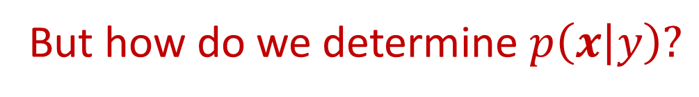
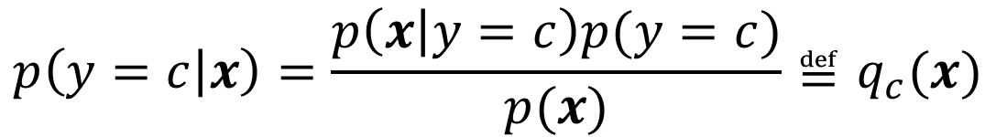
Bayes decision rule
If we know the conditional probability P(X|y), we can determine the appropriate class by using Bayes rule.
$$p\left(y=c | x\right)=\frac{p\left(x | y=c\right)p(y=c)}{p(x)}≝q_{c}(x)$$
But how do we determine $p\left(x | y\right)?$

Slide 17
Naive Bayes assumption
Naive Bayes assumption: Given the class label, the features are conditionally independent.
The model is called “naive” since we expect the features to be independent, even conditional on the class label.
However, even if the naive Bayes assumption is not true, it often results in classifiers that work well.
One reason for this is that the model is quite simple (it only has O(CD) parameters, for C classes and D features), and hence it is relatively immune to overfitting.

Slide 18
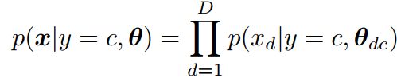
Naive Bayes assumption
Using a class conditional density
where θ_{dc} are the parameters for the class conditional density for class c and feature d.

Slide 19
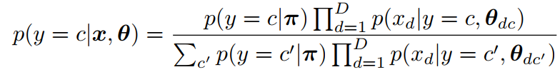
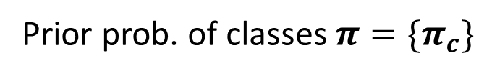
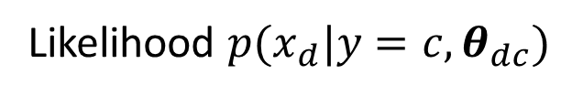
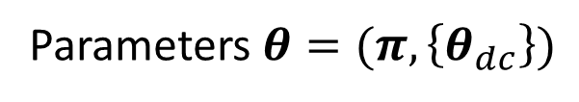
Naive Bayes classifier
Posterior over class labels is given by
Prior prob. of classes $π=\{π_{c}\}$
Parameters $θ=(π,\left\{θ_{dc}\right\})$
Likelihood $p(x_{d}|y=c,θ_{dc})$

Slide 20
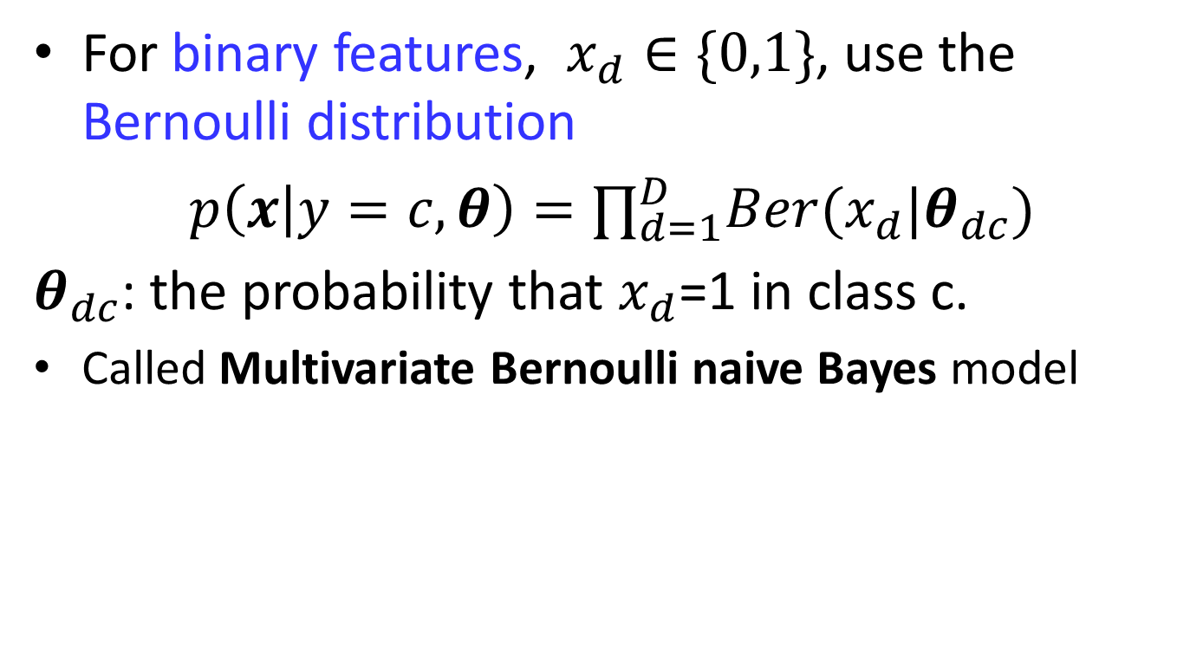
Class conditional density
For binary features, $x_{d}∈\{0,1\}$, use the Bernoulli distribution
$p\left(x | y=c,θ\right)=∏_{d=1}^{D}Ber(x_{d}|θ_{dc})$
$θ_{dc}$: the probability that $x_{d}$=1 in class c.
Called Multivariate Bernoulli naive Bayes model
Figure: Visualization of the Bernoulli class conditional densities for a naive Bayes classifier fit to a binarized version of the MNIST dataset. Test accuracy = 84.3%.

Slide 21
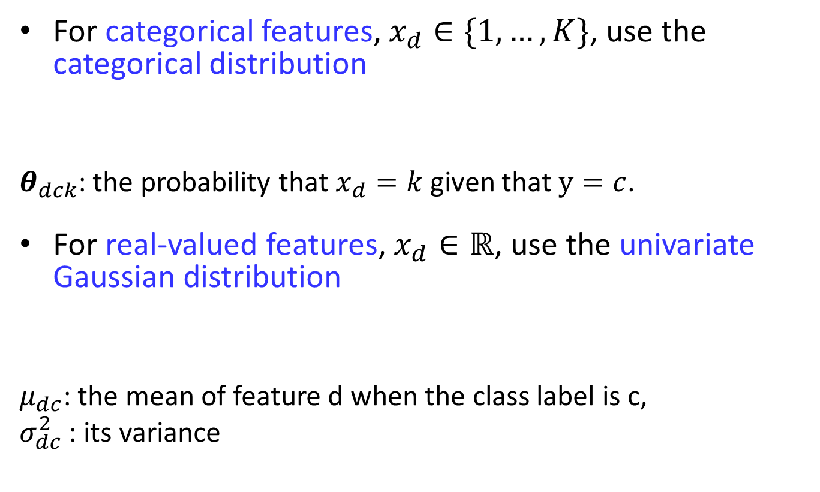
Class conditional density
For categorical features, $x_{d}∈\{1,…,K\}$, use the categorical distribution
$θ_{dck}$: the probability that $x_{d}=k$ given that $y=c$.
For real-valued features, $x_{d}∈ℝ$, use the univariate Gaussian distribution
$μ_{dc}$: the mean of feature d when the class label is c,
$σ_{dc}^{2}$ : its variance

Slide 22
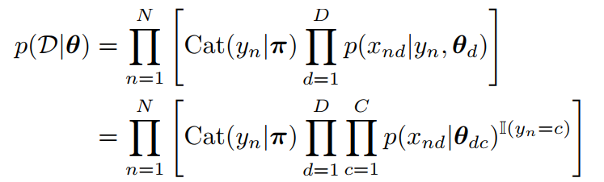
Model fitting
Fit a naive Bayes classifier using maximum likelihood estimation.
Likelihood

Slide 23


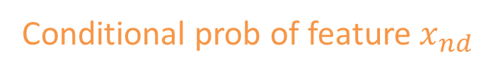
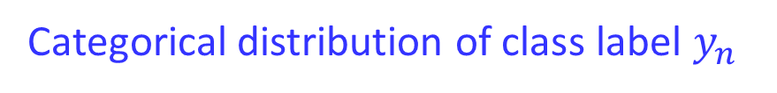
Model fitting
Fit a naive Bayes classifier using maximum likelihood estimation.
Likelihood
Categorical distribution of class label $y_{n}$
Joint prob of dataset D given parameter $θ$
Conditional prob of feature $x_{nd}$

Slide 24
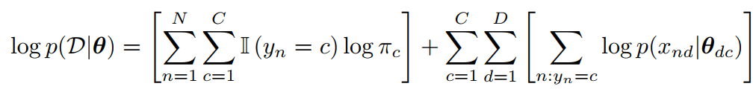



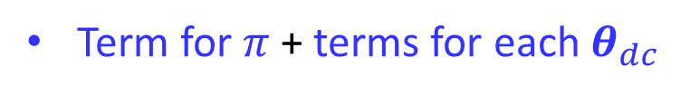
Model fitting
Log-likelihood
Term for $π$ + terms for each $θ_{dc}$
Class prior prob + conditional prob of features
: labels
: feature d for samples from class c

Slide 25




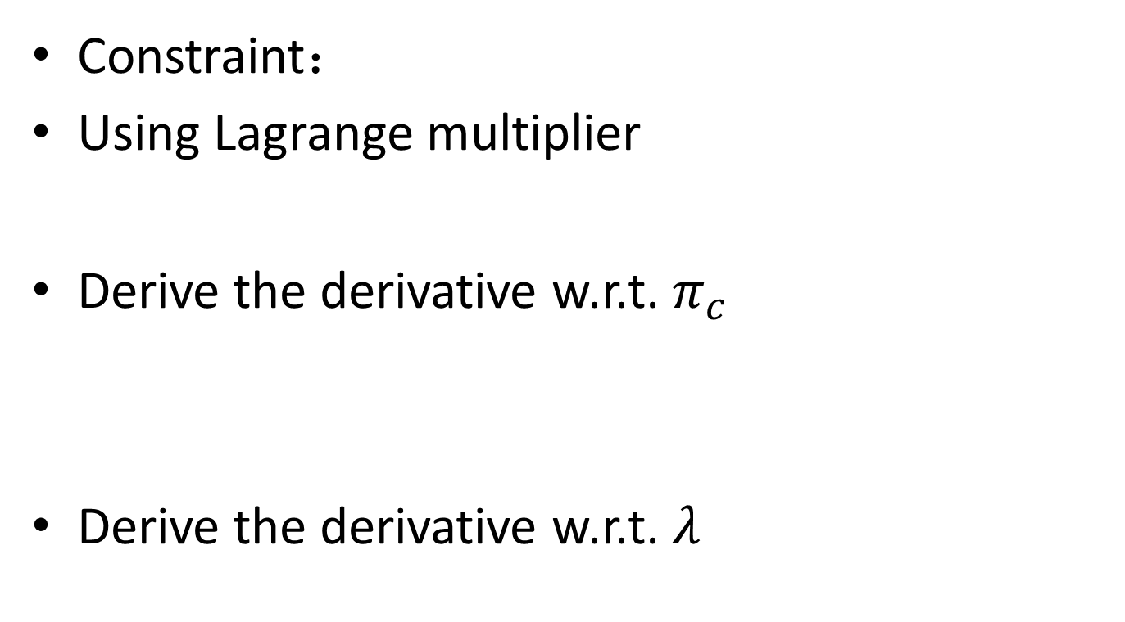


MLE for $π$
Constraint：
Using Lagrange multiplier
Derive the derivative w.r.t. $π_{c}$
Derive the derivative w.r.t. $λ$
$$=N_{c}$$

Slide 26








MLE for $π$
$$=N_{c}$$
$$⇒$$
$$\sum_{c=1}^{C}{N_{c}=N}$$
$$⇒$$
$$\sum_{c=1}^{C}{N_{c}=\sum_{c}^{C}{λπ_{c}}=λ\sum_{c=1}^{C}{π_{c}}=λ}$$
$$\sum_{c=1}^{C}{N_{c}=\sum_{c}^{C}{λπ_{c}}}=\sum_{c=1}^{C}{Nπ_{c}}$$
$$⇒$$
$$π_{c}=\frac{N_{c}}{N}$$

Slide 27
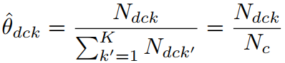
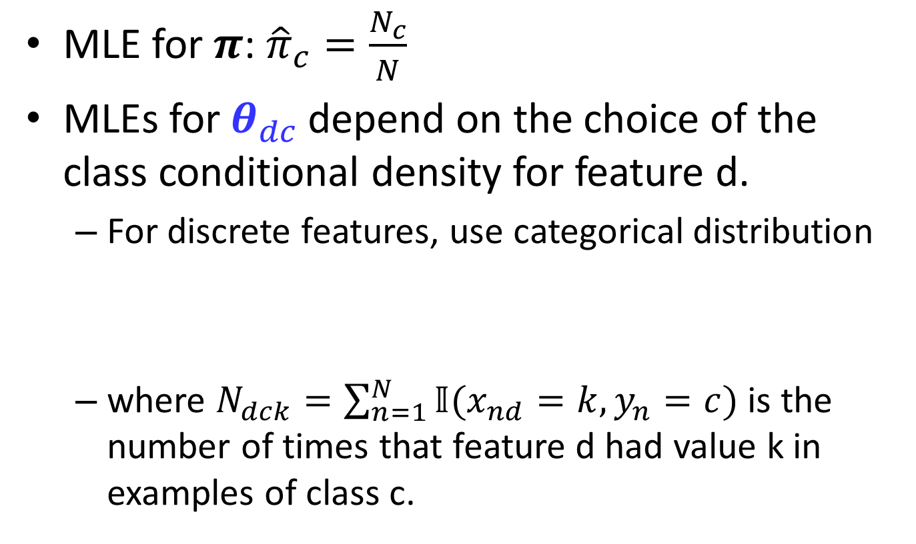
Model fitting
MLE for $π$: ${\hat{π}}_{c}=\frac{N_{c}}{N}$
MLEs for $θ_{dc}$ depend on the choice of the class conditional density for feature d.
For discrete features, use categorical distribution
where $N_{dck}=\sum_{n=1}^{N}{𝕀(x_{nd}=k,y_{n}=c)}$ is the number of times that feature d had value k in examples of class c.

Slide 28


MLEs for $θ_{dc}$
For binary features, the categorical distribution becomes the Bernoulli, and the MLE becomes
which is the empirical fraction of times that feature d is on in examples of class c.

Slide 29
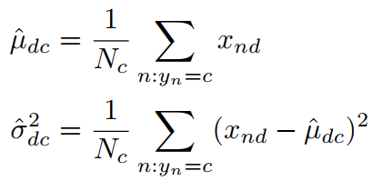
MLEs for $θ_{dc}$
For real-valued features, use a Gaussian distribution. The MLE is
Fitting a naive Bayes classifier is extremely simple and efficient.

Slide 30
The connection between naive Bayes and logistic regression
For simplicity, we assume that the features are all discrete, and each has K states, although the result holds for arbitrary feature distributions in the exponential family.

Slide 31
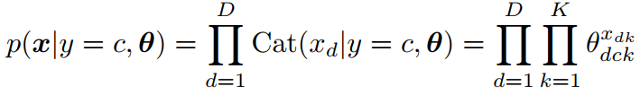
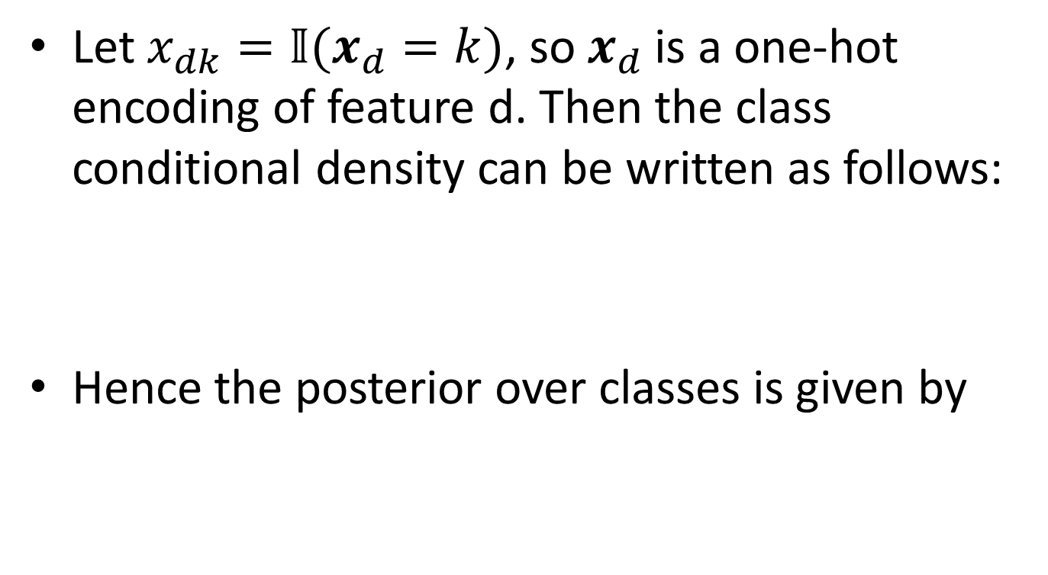
The connection between naive Bayes and logistic regression
Let $x_{dk}=𝕀(x_{d}=k)$, so $x_{d}$is a one-hot encoding of feature d. Then the class conditional density can be written as follows:
Hence the posterior over classes is given by

Slide 32
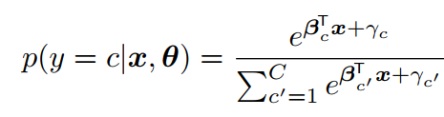
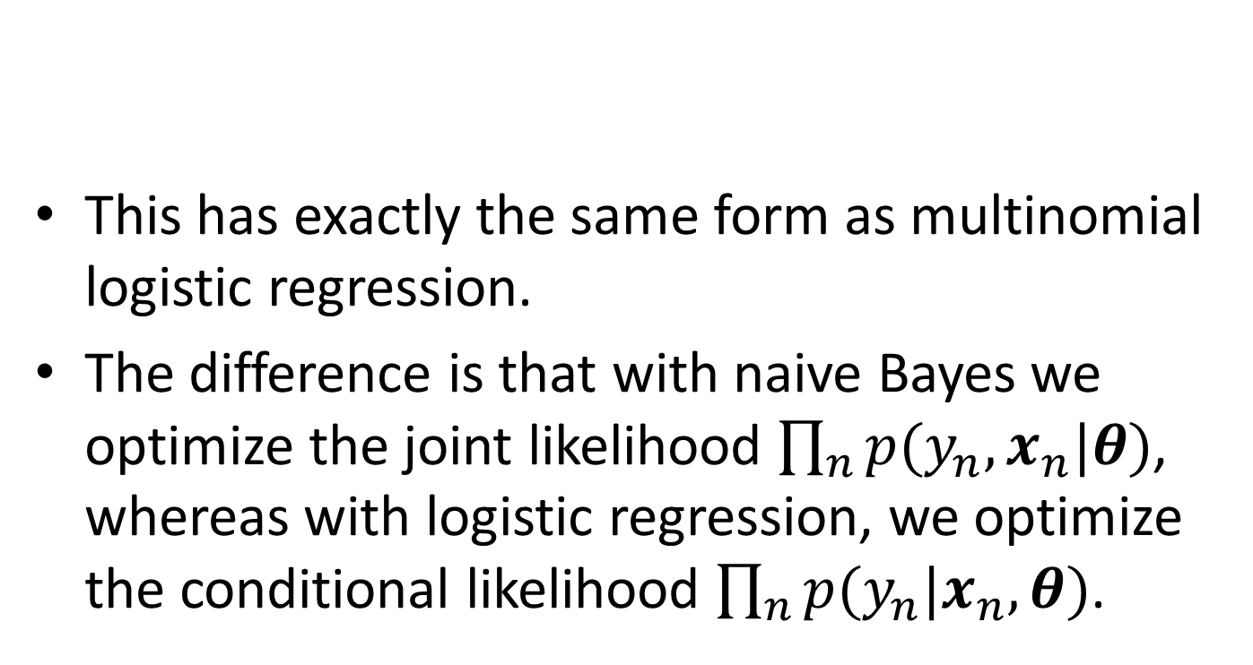
The connection between naive Bayes and logistic regression
This has exactly the same form as multinomial logistic regression.
The difference is that with naive Bayes we optimize the joint likelihood $\prod_{n}{p(y_{n},x_{n}|θ)}$, whereas with logistic regression, we optimize the conditional likelihood $\prod_{n}{p(y_{n}|x_{n},θ)}$.

